Slide 1
Chapter-7
Writing Electronic and other Messages

Slide 2
Memos
The memorandum(plural memoranda), shortly called a memo, is a written communication from one person to another (or a group of people) within the same organization. So, it is regarded as a great means to communication within an organization.
It is normally used for communicating policies, procedures, decisions or sharing information within an organization.
It is often written from one-to-all perspective rather than one-to-one or interpersonal communication.
It may also be used to update a team or activities for a given project, or to inform specific group within a company of an event and action.
Memos once sent out becomes part of the company’s records.

Slide 3
Purpose of Memo
Memos are used in an organization for various purposes like:
Routine message
Short reports
Inquiries
Information sharing
Update team activities
Very often , one need to write persuasive memos to convince co-workers, team members and management of your plans and procedures.

Slide 4
Format of Memo
Memo has a header including name and address of organization and clearly indicates who sent it and who the intended recipient/s is/are as well as subject and date. Subject must be specific and short
To : Arbind Malla, HR Manager
From : Maggie Karki, Managing Director
Date : 5 September, 2020
Subject : Salary increment of some staffs

Slide 5
Body of Memo
After the heading comes the body of the memo, the message being sent.
The opening paragraph contains the purpose and introduce the problem or issue.
The other paragraph(s) give the background information and explanation of the message.
If the receiver/s need/s to take any action that must be mentioned at the end.
I will be talking to Mr James William, our new Sales Director to visit all our Northern branches during week commencing 27 April.
Our visit to your branch will be on Monday 27 April and we expect to arrive at 10:00.
Please arrange for a brief tour to be conducted in the morning followed by a meeting with you.
Please confirm the above arrangements as soon as possible.

Slide 6
Johnson & Johnson Company Pvt. Ltd.
Subidhanagar, Kathmandu
To: All employees
From: John Johnson, Facilities Manager
Subject: Building Remodel
Date: 6 September, 2020
The purpose of this memo is to update all employees on the scheduled building cleaning and maintenance and ensure cooperation.
A crew will be repainting the parking lots on Tuesday. Please park in the indoor garage, which will be free on charge on Tuesday for this purpose.
Power-washing of the building façade will begin Wednesday. As much of the cleaning possible will be performed outside operating hours, but some may coincide with work.
Window washing will take place Thursday from 10 to 4
Cleaning and remodeling of the building’s interior will begin on Friday.
Friday will be an offsite team building day. Free drinks and snacks will be available at Sumai Restaurant.
We, maintenance team, are grateful for your cooperation. Your patience will be rewarded with a beautiful and friendly building. Please direct any questions to johnson@realco.com.
Again, we thank you for your patience.

Slide 7
Assignment
Send a memo to all the employees informing them about the different updated facilities in the office like: spacious parking lot, new office canteen, coffee machines in every floor, expansion of meeting room with projector and added chairs, separate smoking zone, electric attendance machine, air conditioner in every room and time extension for lunch break from half an hour to an hour.

Slide 8
Types of Business Memos
Policy Memo
Companies need to communicate, clearify and explain their policies.
For this, they use memos to convey policy related information to a group of employees.
A policy memo begins with an introduction or background of the stated policy. Then, explains the policy in detail and it may end with a directive towards the implementation of the policy.

Slide 9
Confirmation Memo
A confirmation memo is sent to confirm the information agreed upon during an oral communication such as meeting or briefing.
For example, a manager may send a memo to an employer confirming that the employee will get the required equipment as agreed upon.
Update Memo
It informs the receivers about the progress made in a project or changes made to organizational procedures.
The memo begins with a statement that sums up the existing situation of the last report; then it provides details of the progress or changes occurred in the present point and ends with future expectations

Slide 10
Inquiry Memo
Inquiry memo is written to elicit information.
It may ask the receiver to provide information, explain a procedure or policy and even supply updates on a project.
Depending on the situation, the sender may instruct the receiver/s on how they can send the information.

Slide 11
Guidelines for Writing Effective Memos
Know when to send a memo
Memos once sent out becomes part of the company’s records.
Writing a memo is appropriate in the following situation:
To inform employees about policy changes
To provide updates on work or project goals
To announce appointments, promotions and retirements
To remind team members of the work schedule or goals
To obtain information, facts and data
To call employees’ attention to a specific guideline or policy documents
To invite employees for an event or celebration

Slide 12
Use positive language
Words and expressions carry feelings, emotions and attitudes.
How you say something is as important as what you say.
Avoid negative expressions in any business writing including memos.
Use positive and polite language to build good relations.

Slide 13
Follow appropriate procedure
Each company has its own culture and communication system.
To follow the standard organizational procedures, consider the following:
Make sure to follow the established chain and network of communication. Sometimes sending the memo to the wrong group or sending the wrong memo can be embarrassing.
Consider the standard filing requirements that are in practice in the organization.
Consider an appropriate way of circulating the memo; it can be sent as an e-mail attachment or as a hand-carried document.

Slide 14
Notice
Notices are around us everywhere we go – in the supermarket, on the underground, at the entrance of shopping centers, at the railway station, the bus station, the cinema etc.
It’s a means of formal communication targeted to a particular person or a group of people.
It’s like a news item informing such person or persons of some important events.
This can be an invitation to a meeting, an announcement of any event, to issue certain instructions, make appeals etc.
It is generally written and then displayed at a public place, where it is accessible to all.
It can be pasted on notice boards.

Slide 15
If it is meant for wider audience, it can even be published in the newspaper.
When the government issues notice, it must be published in a national or a local newspaper.
Most organizations have noticeboards posted around the offices which are used to bring special item to the attention of all staffs.
Notice boards may be sectioned according to different topics, for example policy matters, health and safety, staff announcements etc.
It is a good idea to nominate one person to be in charge of each notice board. This person should be responsible for:
removing obsolete(dead) notices
sectioning notices under appropriate headings where possible
keeping the notice board tidy and clean

Slide 16
Notices can serve a number of purposes:
Announce social events
Report on matters of interest to staff
Inform staff of new procedures
Advertise posts for internal appointment
Remind staff of company procedures

Slide 17
Qualities of an Effective Notice
Brief
Notice should be short and precise.
There shouldn’t be any emotional expression.
Sentences should be short, concise and carry a complete thought.
Complete
Notice should provide complete information and clearly state its purpose.
It must provide a clear sense of who, what, when, where and how.
A notice should not leave any room for further inquiries or clarification.

Slide 18
Clear
Like other business writing, a notice must provide clear information about the subject, event or activity announced.
As the main purpose of a notice is to inform readers about a subject, the language must avoid ambiguity, vagueness and complexity.
Formal
It must be formal in tone and language.
Authority
To be credible, a formal notice must bear authority.
The individual. Agency or organization that issues the notice authorizes the notice with a valid signature and an official seal.

Slide 19
Format of a Notice
Header
It begins with the name of issuing organization and address on the top followed by date and short as well as catchy title.
Body
Body provides specific details regarding what the notice is about
It answers the question to what, when, where, who and whom.
Authority/Contact person
It usually ends with the name and signature of the individual or head of the organization issuing notice.
If the matters or items need to be handed in, this section also includes the phone number and address of the person to be contacted.

Slide 20
Designing Notices
When designing a notice, the first aim must be to ensure that the notice is seen clearly and acted upon where necessary. Long, rambling paragraphs will not achieve this aim.
Follow these guidelines when designing notice:
Give a clear heading
Use different size print for emphasis
Use sub-headings to break up the main information logically
Use bullet points to display points on separate line
Use the paper effectively to display the notice attractively
Include the name of the writer at the bottom as well as date

Slide 21
Assignment
Write a notice to circulate in the different sections/faculties of an organization stating that there will be electrical repairing on the date 30th June and electrical equipments will not be in use for the whole day. In addition to this, calls can’t be transferred. Also, advise the staffs to do the paper related work on that day.

Slide 22
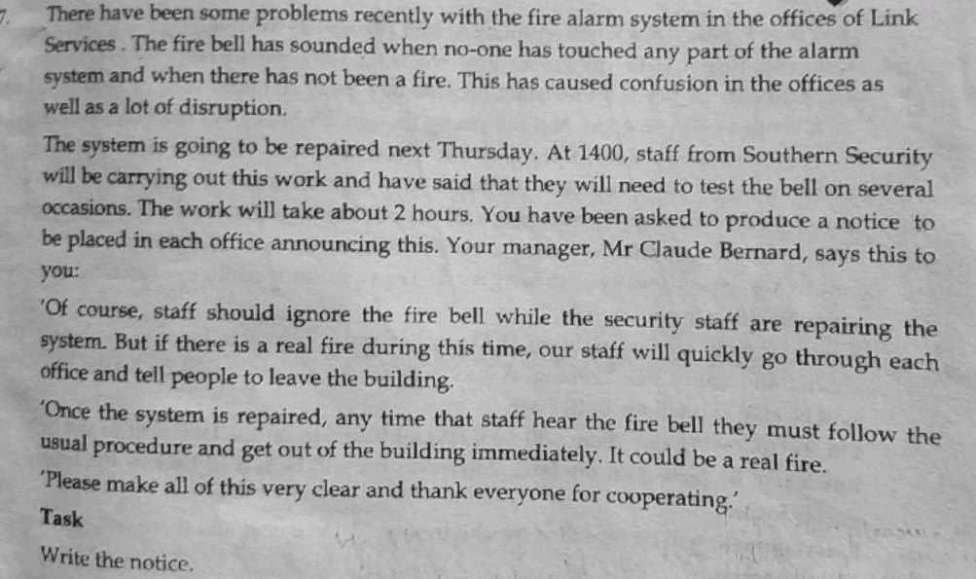

Slide 23
Electronic Mail
E-mail is a short form that stands for electronic mail. It is sent to people within or out of the organization via internet.
Businesses today operate in a highly competitive market in which high-speed communication and information transfer is essential. Most of the activities in today’s offices are electronic, using computer-based technology.
E-mail is the best medium of communication at present time.
In fact, e-mails have replaced the traditional forms of written messages like letters and memos.

Slide 24
Advantages of E-mail
Quick
Secure
Low cost
Attachment(s)
More than one recipient

Slide 25
Guidelines for writing e-mail
Determine the need for sending an e-mail
Sending e-mail unnecessarily ends up reaching an unintended audience.
While communicating through e-mails, first consider whether there is an actual need for an e-mail.
2. Use a standard heading
E-mail system automatically generate the heading that includes: From, To, Subject and Date.
We have to fill up the information for the To and Subject.

Slide 26
3. Copying e-mails
While sending an e-mail to the main recipient, you can send it to someone else.
All e-mail systems have built in Cc and Bcc sections in the header to facilitate copying an e-mail with ease.
Use Cc if you want the main recipient to know that you have copied the e-mail to someone.
If you would rather not disclose this fact, then you can use the Bcc section.

Slide 27
4. Use effective subject line
Subject line should let the recipient know what the e-mail is about.
Unfortunately, people often overlook the importance of the subject line.
Unless you are exchanging e-mails to and fro on the same subject to a recipient, you should always have a suitable line.
Subject line must be brief and clear.

Slide 28
5. Know your audience
People have different expectations about how an e-mail should be like and how they want to be addressed.
We must maintain the courtesy and tone while writing an e-mail.
The choice of tone and way we address the recipient depends on how familiar we are with him/her.
If not, then we can address the recipient more formally.

Slide 29
6. Organize the message effectively
E-mail is not an ideal medium to communicate complex messages with multiple subjects, points and paragraphs.
To be effective, an e-mail must be short, direct, precise and focused on a single subject.
while organizing an e-mail:
Begin by briefly stating the purpose of writing an e-mail.
Provide adequate context for the message. For example, if you are asking questions or seeking an explanation, quote or refer to any relevant section form the sender’s message.
Add relevant details, explanations and information.
Use paragraphs to separate thoughts and ideas to help the recipient understand the message clearly.
Conclude the body stating what you expect from the reader - a response, meeting, information or explanation.

Slide 30
7. Closing
Like in business letters, closing an e-mail is very important.
Firstly, closing helps you to build goodwill; secondly, it lets the recipient know who is communicating to him/her.
For less formal e-mails, consider signing off with a brief friendly word or phrase like – Thank you, Best wishes, Regards along with your complete name.
For more formal e-mail, consider using expressions – Sincerely, Respectfully, Your sincerely.

Slide 31
Assignment
You are the manager of a company. The company has a provision to provide a mobile set to each employee during his/her tenure. Write an email to your supplier requesting him/her about the specifications of best mobile set available in the market around 15K.

Slide 32
Press Release
A press release is a short official written communication issued by a company.
It’s main purpose is to announce important and specific news regarding an event, product, service or changed circumstances.
Situations that call for a press release include – launching a new business or product, announcing new leadership, or responding to an issue or problem.
Well timed and well covered press releases help companies gain publicity and reach the mass.
However, a press release should not be treated as a tool to promote a product or service.
Based on the situation and purpose, the following are the common types of press releases issued by a company.

Slide 33
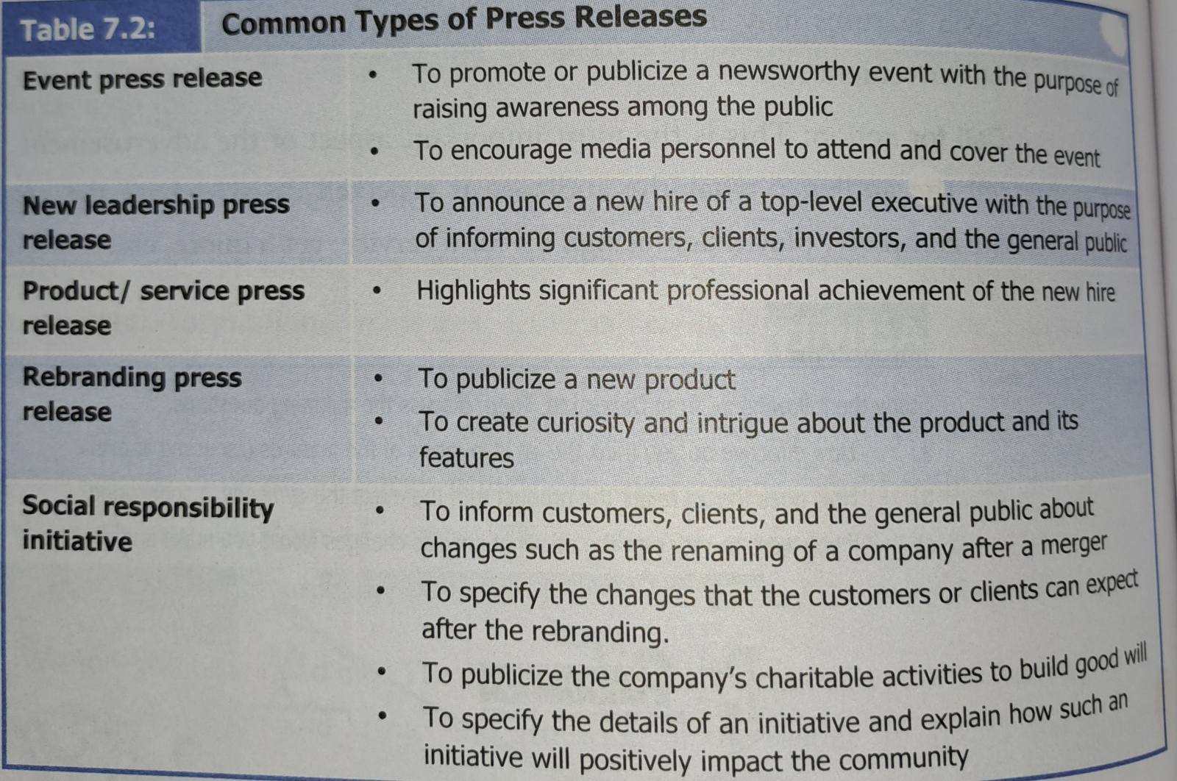

Slide 34
Format and guidelines for writing a press release
Press release follow a common format that a journalist is familiar with.
A press release must be newsworthy, that is, the news and its content should be timely, important and interesting.
A typical press release follows the style of journalistic writing – direct, factual and informative.
Head
It includes the organization’s name, logo and address followed by the phrase “Press Release” centered on the top margin.
This allows journalists to immediately recognize the document as a press release.

Slide 35
Dateline/release date
The dateline refers to the date the press release is to be published.
The first paragraph of the press release begins with the name of place and date, separated by a hyphen(dash).
Depending on the timing and situation, we can write the phrase “For Immediate Release” if we wish to distribute it immediately.
Alternatively, we can mark it as “Embargoed for Release”, followed by a date (other than the date released), if you want news outlets to hold on to it until the specified date.

Slide 36
Headline
Every press release must have an interesting and catchy headline that lets the audience know what the press release is about.
The headline appears at the top of the press release but below the organization’s logo, contact information and date.
If you wish to get the release published on the internet, consider including a few key words in the headline.

Slide 37
Opening paragraph
The opening paragraph usually appears under summary bullets.
The first body paragraph is crucial as it should answer the most important questions – who, what, where, when, how. For an effective release, develop this paragraph as a summary of the entire release.

Slide 38
Remaining section
This section of the body may include multiple paragraphs.
It explains the main theme or central idea of the release.
In this section, include relevant images, graphics and even video clips.
Also consider including brief quotes from higher management people to ensure the credibility of the news.
If you are sending the release in a digital format, provide links to relevant webpages and other media content.

Slide 39
Boilerplate
A boilerplate is the final paragraph of the news release.
It provides background information about the organization.
This paragraph should be brief and precise but ideally should present the organization in a positive light.

Slide 40
End notation
End the news release with the notation of three hashes (# # #); however, if the release has two pages, end the first page with “More…” to indicate that the release continues on the next page.
At the end, add contact information such as an e-mail or phone number. The notation sentence may begin as: “For information, contact us”.
Note: See page 200 for the sample of news release.

Slide 41
Blog
Blog is a personal journal published on the web.
It is meant for sharing opinions, ideas, thoughts and feelings with others.
It is dynamic and interactive as the readers can comment and respond to its content.
The writer can provide timely information and updates on a topic.
There are millions of blogs available on the internet in many subject.
Moreover, the writer can create hyperlinks, tags and embed links in other social networking sites to reach to multiple groups of audiences.

Slide 42
Organizational Blogs
Organizational blogs have become increasingly popular among many organizations.
Companies such as Microsoft, Google, General Motors etc encourage employees to create blogs.
Due to the immense potentiality of reaching out to a wider audience, companies, government agencies, and non profit organizations create blogs to achieve their specific goals.
Such goals include - attracting and retaining clients or customers, promoting and obtaining feedback on their services and products, developing a sense of community.
Organizational blogs can be categorized into two main types: internal and external blogs.

Slide 43
Internal organizational blogs
Companies create internal blogs for their employees who can access the content through their organization’s internet site.
Such blogs function informal communication forums for employees to share information and discuss issues and problems.
Internal blogs also help develop a positive communication culture in the organization.
They also enhance employees’ participation in a variety of activities, including promotional and social events. Blogs also serve as an effective medium to publicize news, events and community engagement programs.

Slide 44
External organizational blogs
External organizational blogs are publicly available on the internet.
Companies utilize the blogs to reach a wider audience.
External blogs help companies in developing positive relationships with clients, customers and stakeholders.
Such blogs work for building the company’s credibility, to spread product and service related information.
Due to their interactive and dynamic nature blogs allow companies to obtain feedback from customers and clients on their products and services which ultimately helps companies assess and improve the quality of its products and services.

Slide 45
Guidelines for writing effective blogs
Planning the blog
Find the right blogging platform
If you are writing blogs for your company, you probably do not need to find a platform to publish your posts.
All you need to do is to create blog posts and get them published on the company’s dedicated blogging site.
If you plan to create a personal blog, then you need to find a blogging platform.
You can either sign up with a free blogging site or a platform such as Blogger.com, WordPress.com or Tumblr.com or set up the blog through a Web hosting service with a registered domain name.

Slide 46
Select the topic and set your goals
If you are planning to create a personal blog, you want to select a topic that not only interests you but also appeals to your target audience.
Selecting a topic in your area of expertise and knowledge is a good beginning.
If you plan to contribute to your company’s blogging site, you want to establish a clear goal.
Think of what you want to achieve from the blog and what you want readers to take from it.
Depending on your company’s needs and policies, you may have several areas to choose from, including customer service, product promotion, relation building and community engagement.

Slide 47
Identify the target audience
Blog are meant to be read and are intended to facilitate meaningful interaction with the readers.
Internal organizational blogs will have a fairly identifiable audience. You can think of managerial, non-expert and expert audiences.
Identifying a specific group of target audiences not only helps you adopt an appropriate style of writing but also select topics and issues for the blogs.
Topics for internal organizational blogs may include professional development stories, work and travel experience, policy explanations and upcoming events.
For external organizational blogs, the target audience may include clients, customers, stakeholders and even the general public.
You can further analyze audience in terms of gender, age, level of income and location.

Slide 48
Writing blog
Craft your title
The title of the blog should attract the reader’s attention and should follow the best SEO ( Search Engine Optimization) practices.
For this, include a couple of relevant and strong key words in the title.
Use a short title of 40-60 characters for your blog.
Introduction
For introduction, avoid unnecessary background information.
Directly dive into the topic.
To make the introduction interesting, think of beginning with a startling statement, a personal anecdote or fascinating facts.

Slide 49
Develop and organize the body section
Body section is the main part of the blog post.
After you gather information, facts and details, organize them in such a way that the readers can easily follow ideas and information.
For this, consider using headings, subheadings, bullet points, graphic features to emphasize key ideas.
You can use relevant images, graphics, video clips and audio files to make blog attractive and engaging.
Conclusion
It must be emphatic and memorable.
Usually a conclusion provides the main point summary but in a blog, the conclusion may call for action.
In an organizational blog, this is where the writer can provide a link to a product, ask the reader to contact them for additional information, invite readers to comment on or share the blog.

Slide 50
Reviewing the blog
Blogs, especially external organizational blogs, are viewed and read by a wide range of audiences.
A sloppy and error loaded blog published on the internet negatively reflects on you and your company.
Carefully review blog posts and revise them to ensure accuracy, preciseness, relevancy of the content and appropriateness of style.

Slide 51
Publicize the blog
Once you are satisfied with the writing after necessary correction and revision, post the blog on the internet.
To help the readers discover your blog, consider:
Provide internal and external links to other relevant blogs and webpages.
Share your blog on social media such as facebook and Twitter.
Provide links to your blog in e-mails and other means of communication.

